Slide 1
Smart Skies: AI Powered Object Detection
Aalto University Summer School 2025
Name: Ali
Date: 1st Aug,2025

Slide 2
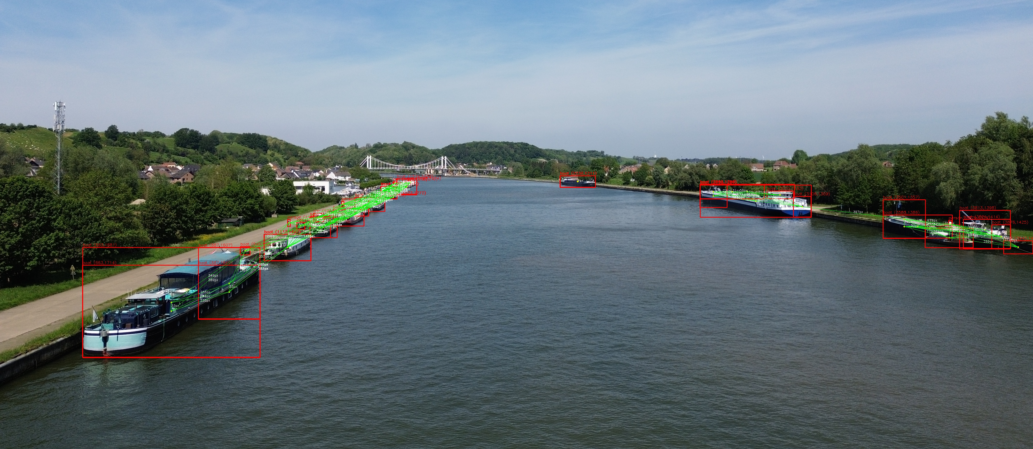

Motivation
Why use AI + drones?
Applications: Urban, security, and environment planning

Slide 3
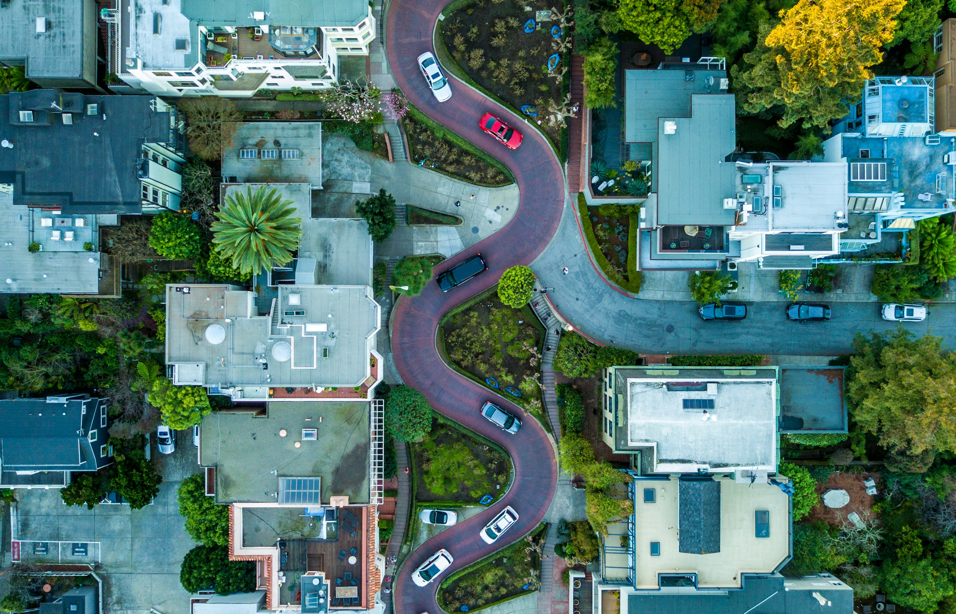
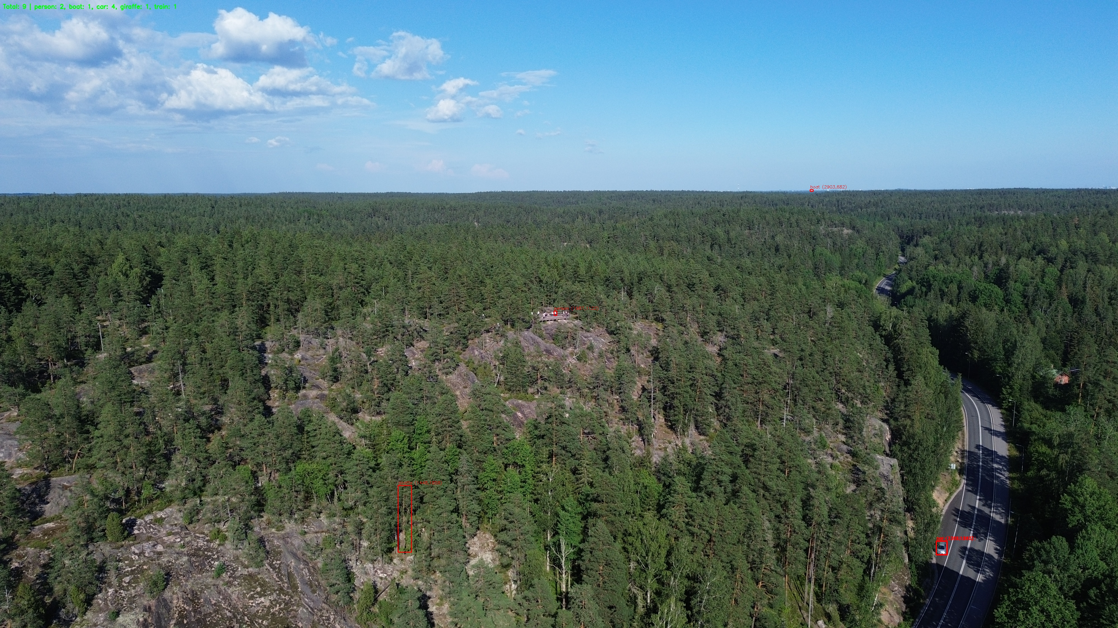
Hardware Setup
Captured via DJI Mini 3 (vertical & horizontal axis configurations), processed locally.

Slide 4
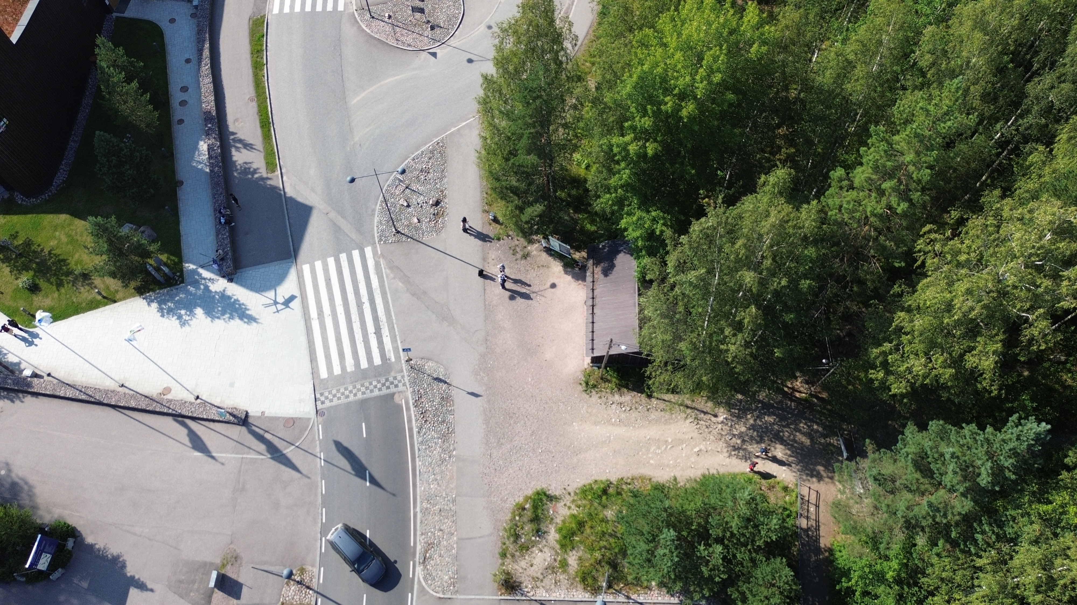

What is Object–Detection?
Popular models: YOLO, SSD, Faster R-CNN
Bounding boxes + ClassificationBoxes + Classification
Before
After

Slide 5
YOLOv8 Model
Why YOLOv8x? (Accuracy over speed)
Key advantages: pre-trained, strong on small objects, works with tiles
Model variations: n, s, m, l, x (used x)
You Only Look Once(YOLO) :)

Slide 6

Image Tiling
Problem with big drone images
Solution: Split image into overlapping tile.

Slide 7
Detection Pipeline
1. Load Image
2. Tile + Overlap
3. Run YOLOv8x
4. Merge Results
5. Draw Bounding Boxes
6. Generate Heatmap + Output Picture

Slide 8
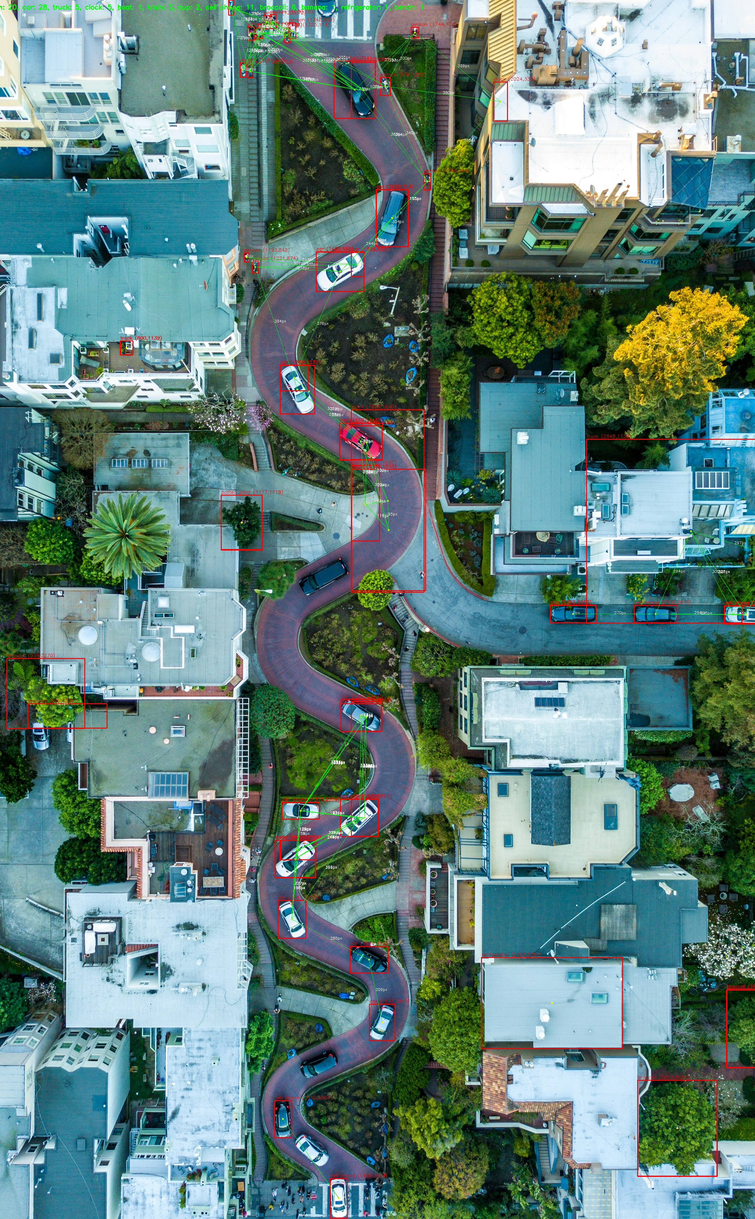
Detection Output
Image: Final image with red boxes + pixel coordinates
Highlight: clear detection even on small objects

Slide 9
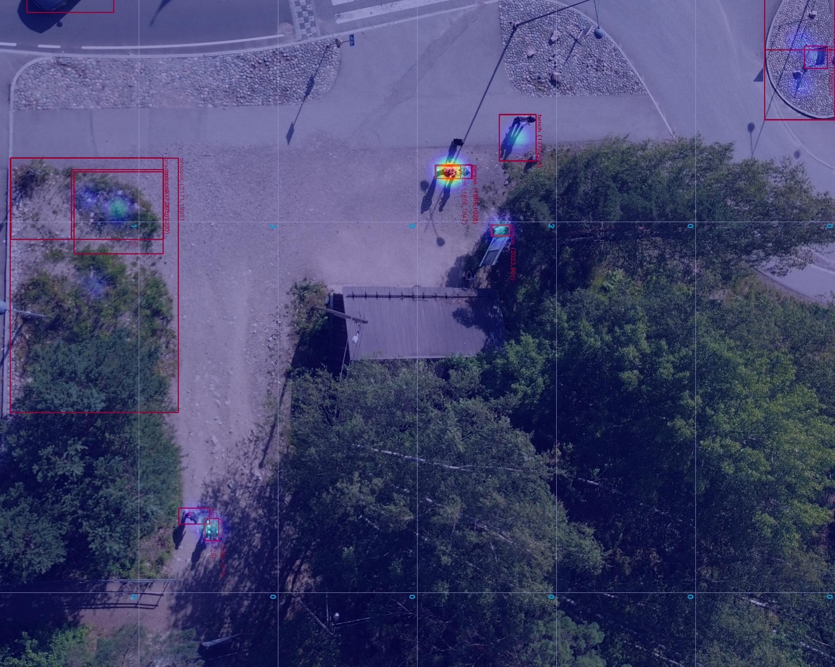
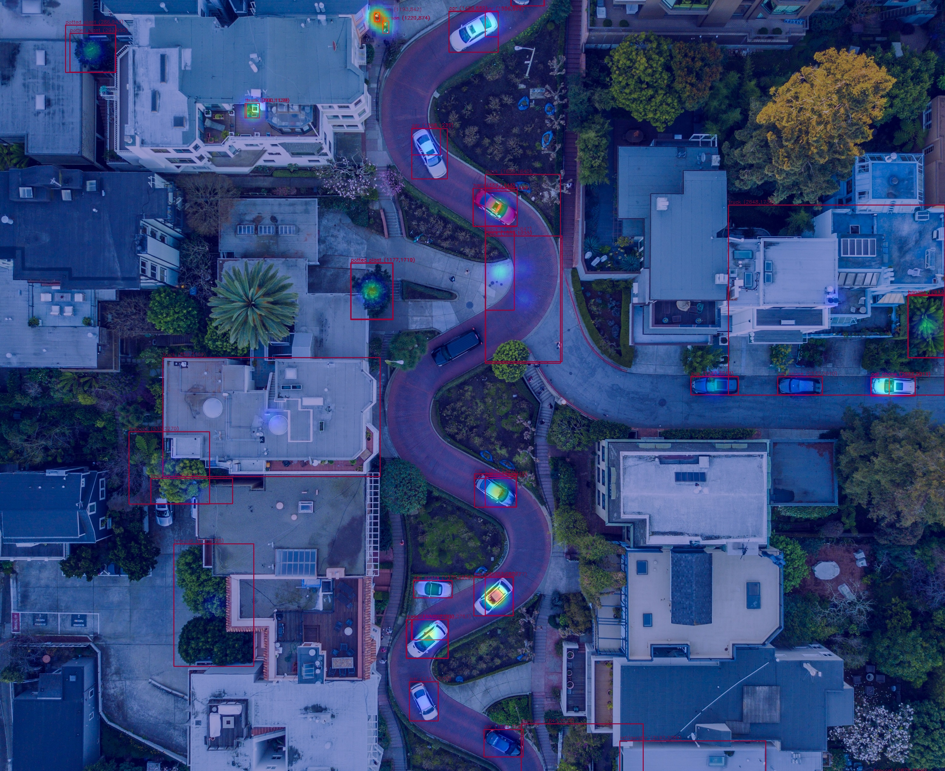
Heatmap + Grid Overlay
Heatmap shows density of detected objects
Grid layout added for spatial awareness

Slide 10
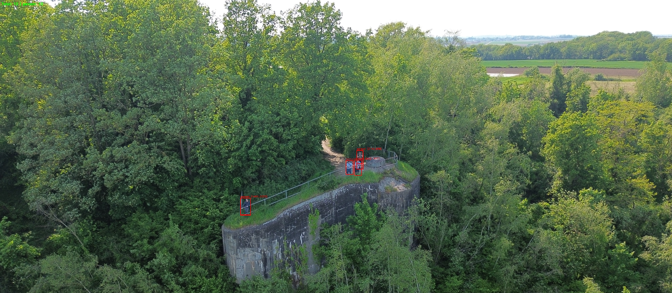
Extra Features
Coordinate labeling per object
Object distance measurement (lines between close objects)
Color-coded connections

Slide 11
Improvements & Future Work
Add trajectory prediction for videos
Custom model training
Use GPS metadata and real-world scaling
Add tracking across frames for real-time insights
Explore deployment on edge devices (Jetson Nano, Raspberry Pi)

Slide 12
Challenges
False positives on small objects
Vertical footage cropping or padding
Some distant objects not detected due to scale

Slide 13
Live Demo

Slide 14
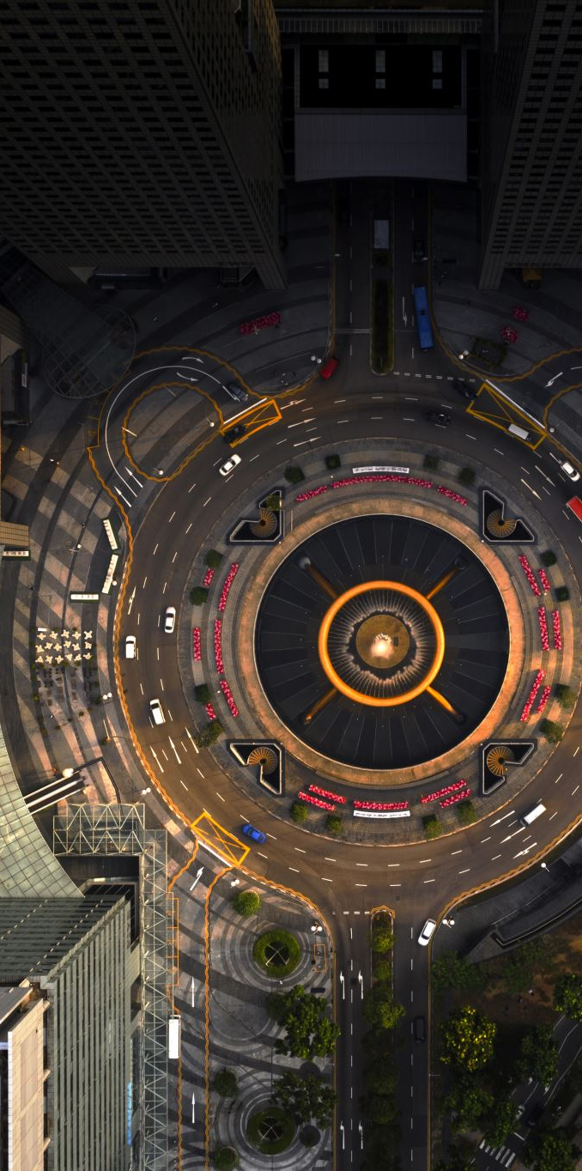
Conclusion
AI + Drones = Powerful Vision Tools
Real-world value in GIS(Geographic Information Systems), smart cities, and safety
Many fun possibilities ahead with video, tracking, and automation

Slide 15

Q&A
Any questions?

Slide 16
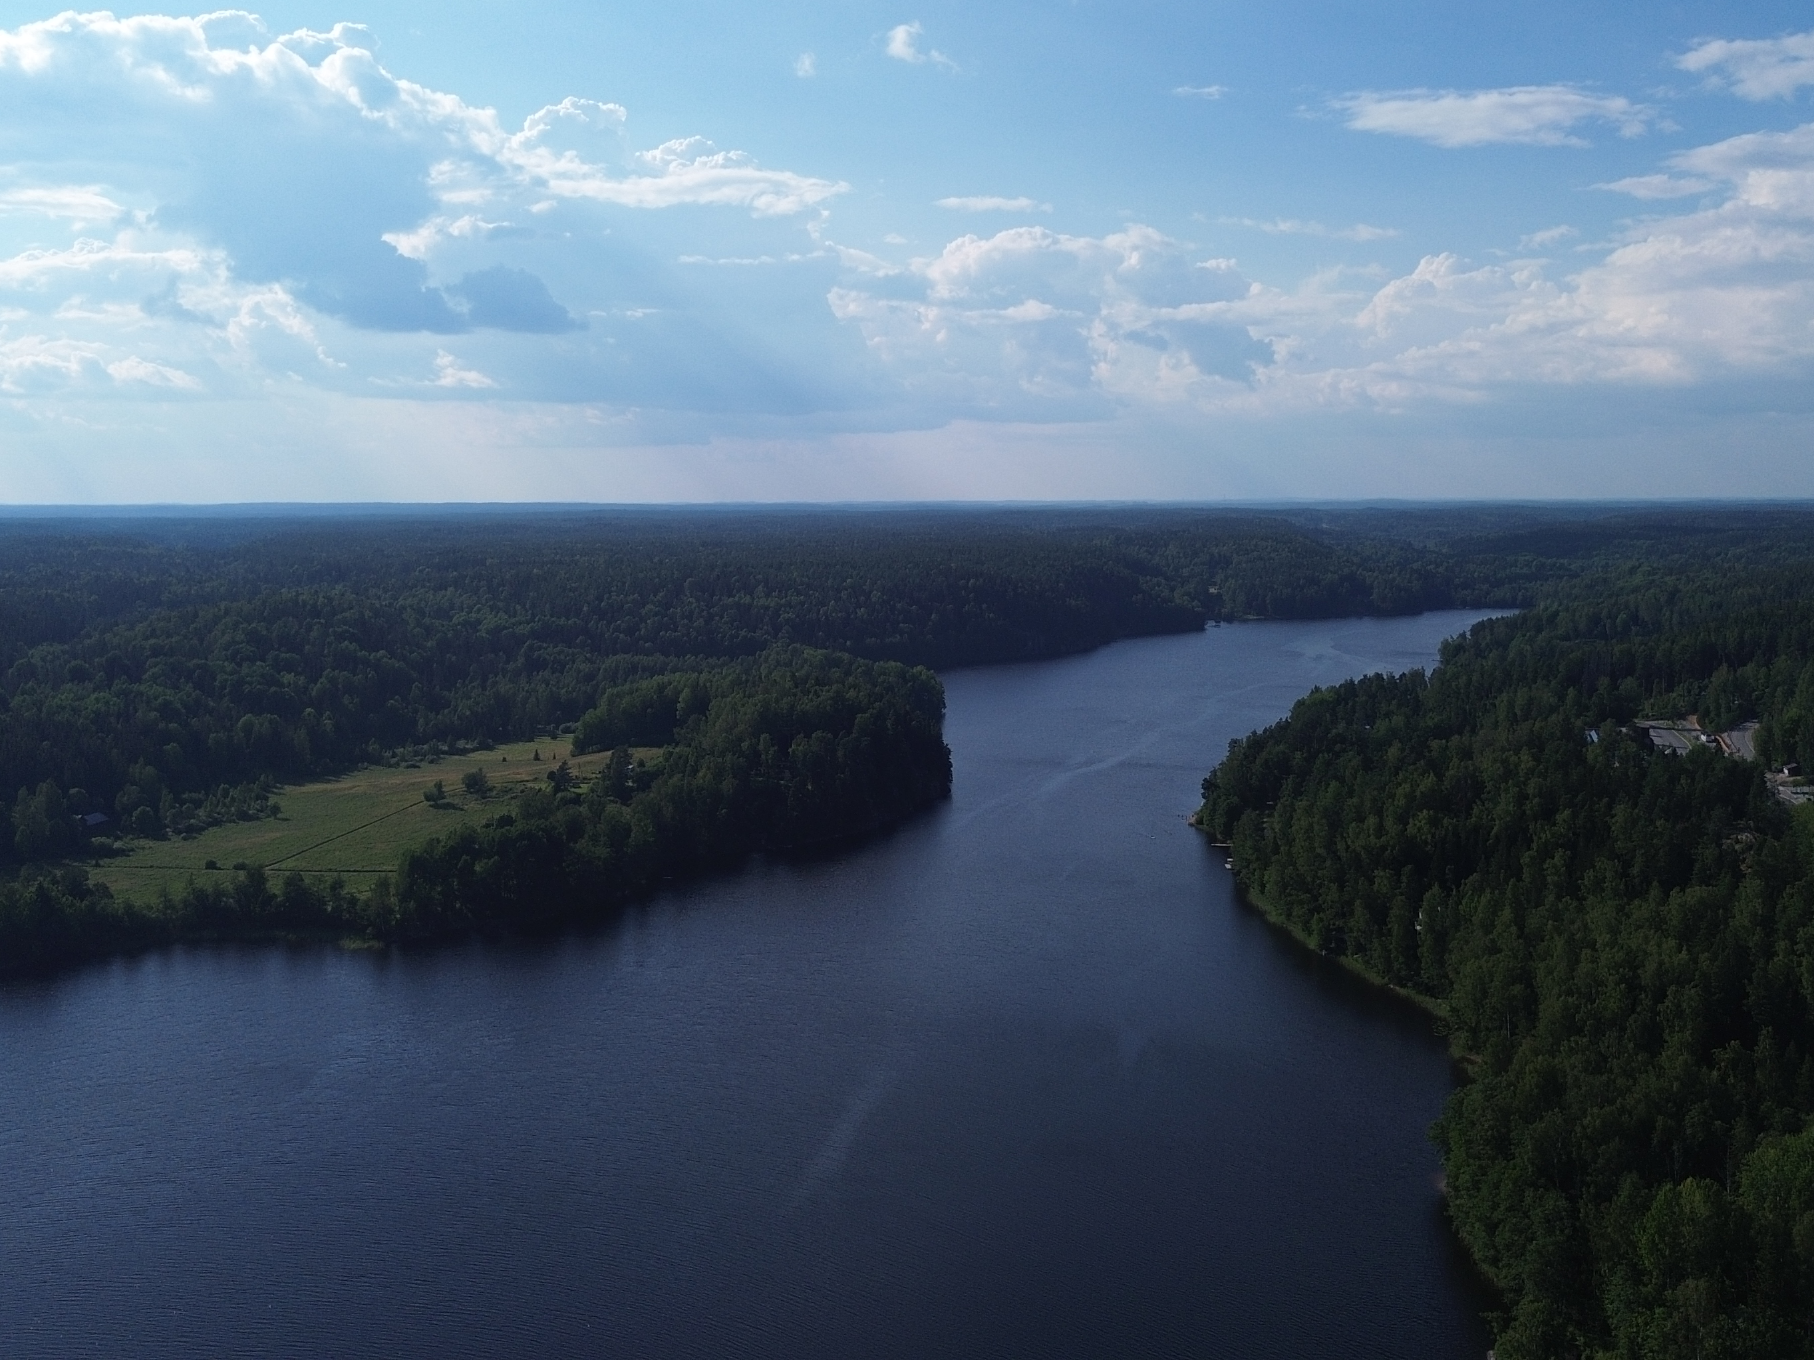
Thanks!

